Slide 1
Customer Segmentation for Marketing Offer Strategy
Optimizing Engagement & Revenue with Data-Driven Offers
👤 Presented by Marianna Gokova
📊 SQL | Python

Slide 2
Executive Summary
We used K-Means clustering to segment users based on 23 features: session behavior, spending, and discount sensitivity.
3 Segments Identified:
🟢 Cluster 1: Heavy Spenders (~$65K, low discount use)
🔵 Cluster 0: Moderate Travelers (~$17K, families)
🟡 Cluster 2: Budget-Conscious (~$7K, high discount sensitivity)
🎯 Goal: Deliver personalized offers to increase engagement and conversion.
🛠 Tools: SQL, Python, Seaborn

Slide 3
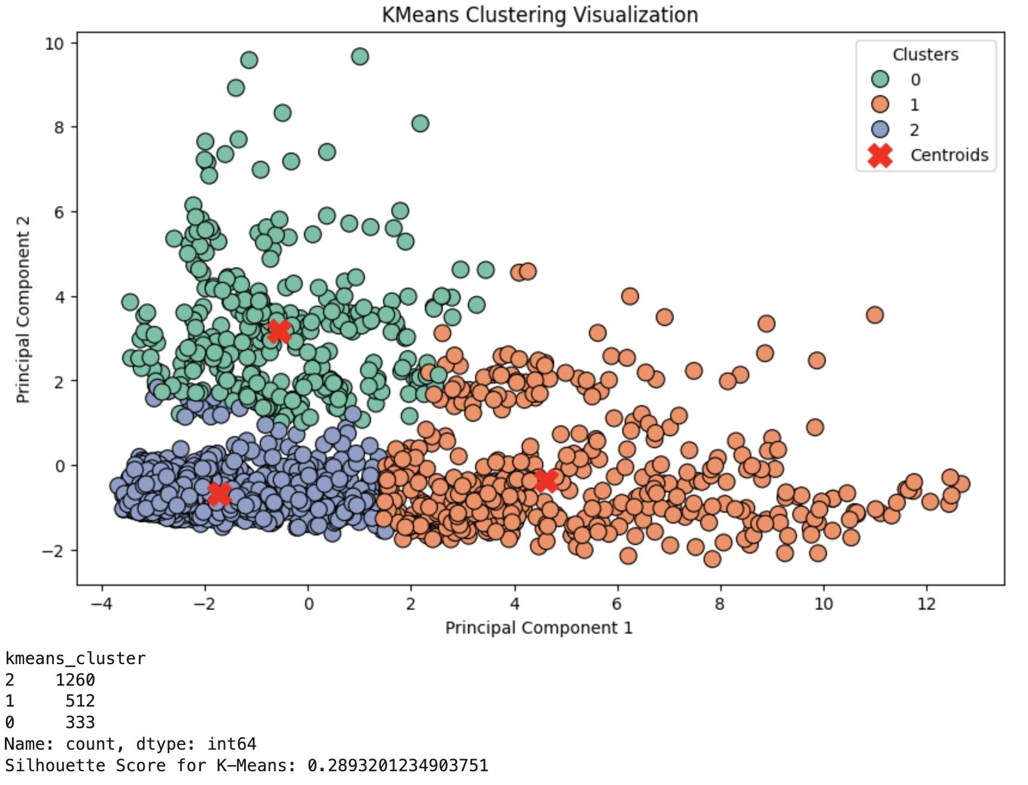
Cluster Visualization (PCA Plot)

Slide 4
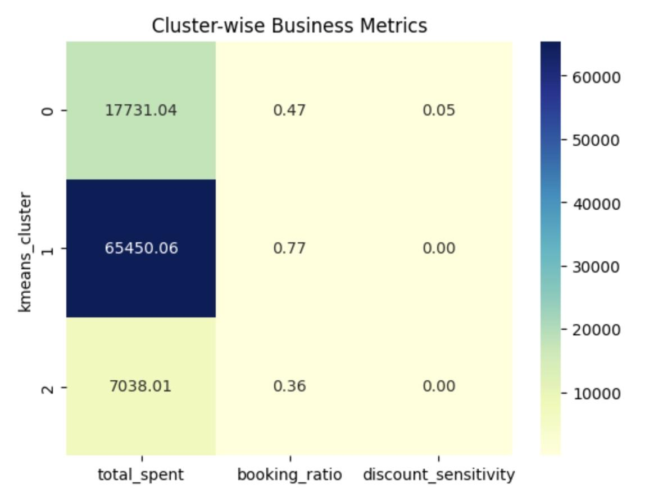
Business Insights by Cluster
Metrics by Cluster:
Cluster 1: 💰 Highest spend, most bookings
Cluster 0: Balanced engagement
Cluster 2: Low spend, high discount interest

Slide 5
Segment Profiles & Offers
📈 Targeted offers can improve ROI & retention.
Cluster | Profile | Offer
🟢 1 | High spenders, loyal flyers | 1-Night Free Hotel
🔵 0 | Moderate travelers, families | Free Checked Bag
🟡 2 | Low activity, price sensitive | Exclusive Discounts

Slide 6
Customer Overview & Funnel Steps
Our users are travelers engaging with our platform across browsing, booking, and discount usage stages. We focus on key funnel steps:
Session Engagement – How often and how long users interact
Booking Behavior – Flights, hotels, cancellations, checked bags
Spending & Discounts – Total spend, discount use, sensitivity
Demographics – Age, family status
These steps help identify value, intent, and marketing potential across segments.

Slide 7
Cluster 1 – Heavy Spenders & Frequent Flyers
Profile Summary:
Age: ~45.7 years
Marital/Family Status: 44% married, ~30% with children
Engagement: Extremely active — 81 sessions, ~64 bookings
Spend: ~$65,450 total, with very low discount sensitivity
Behavior: Books both flights and hotels frequently, stays ~3 nights per booking
Spending Efficiency: Highest spend per session (~$811)
Marketing Takeaway:
These are your premium users. They value service and convenience over savings. Focus on loyalty programs, VIP offers, and exclusive perks to keep them engaged

Slide 8
Cluster 0 – Moderate Travelers (Families & Leisure Focused)
Profile Summary:
Age: ~42.8 years
Marital/Family Status: ~49% married, ~36% with children
Engagement: Moderate — 31 sessions, ~16 bookings
Spend: ~$17,700 total, moderate discount sensitivity
Behavior: Uses both hotels and flights, likely for family vacations
Efficiency: Balanced booking and session ratio, spends ~$550 per session
Marketing Takeaway:
These are mid-tier travelers, often with families. They respond to practical incentives like free checked bags, bundled travel packages, and loyalty point boosts.

Slide 9
Cluster 2 – Light Users & Budget-Conscious
Profile Summary:
Age: ~42.2 years
Marital/Family Status: ~46% married, ~37% with children
Engagement: Low — 21 sessions, ~9 bookings
Spend: ~$7,038 total, high price sensitivity
Behavior: Books less frequently, mostly short stays (~3 nights)
Efficiency: Lowest spend per session (~$269), responds to discounts
Marketing Takeaway:
This segment is cost-conscious and low-engagement. Target with flash sales, “no cancellation fee” offers, and price-based re-engagement emails.

Slide 10
📢 Marketing Recommendations by Segment
🔹 Cluster 1 – Heavy Spenders: Focus on loyalty and premium experience. Offer VIP perks like free hotel nights, priority check-in, or exclusive partner deals. These users don’t respond to discounts, so build emotional loyalty.
🔹 Cluster 0 – Moderate Travelers: Promote family-friendly and practical offers such as free checked bags, bundled travel deals, or reward point boosters. Ideal for seasonal promotions and cross-sell opportunities.
🔹 Cluster 2 – Budget-Conscious Users: Use discount-driven campaigns, flexible booking terms, and re-engagement emails. Emphasize savings and ease — perfect for flash deals or last-minute travel incentives.

Slide 11
🙏 Thank You!
We appreciate your time and attention.
🚀 Next Steps:
Launch targeted campaigns per cluster
Build dynamic dashboards for real-time monitoring
Integrate recommendations into ongoing CRM workflows
Let’s make every offer count. Questions? Ideas? Let’s discuss.

